Slide 1
Transitioning to a Newsroom Model
Austin ISD Department of Communications and Community Engagement
Notes:
Cristina - Overview

Slide 2
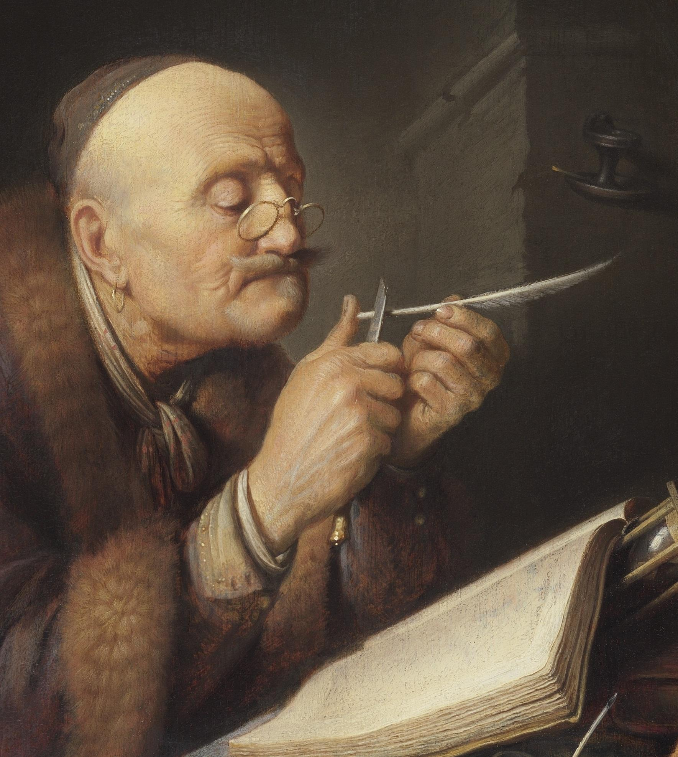
The Before Times
Notes:
Letters
Official statements
Everything is hush hush

Slide 3
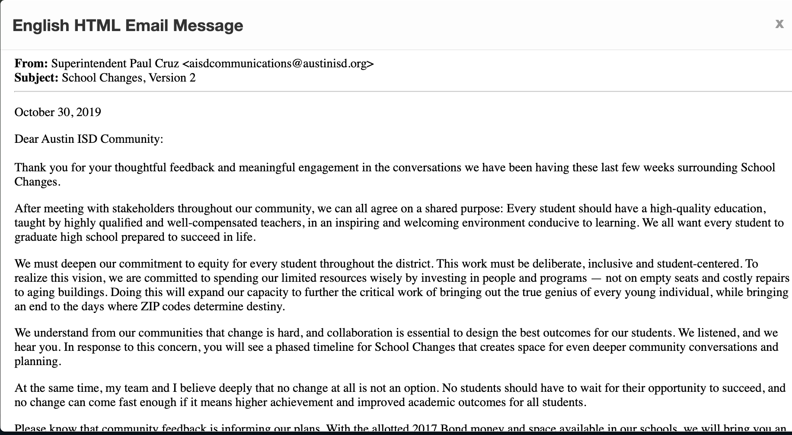
The Before Times
Notes:
Show them where the point is

Slide 4
The Before Times
The point
Notes:
Show them where the point is

Slide 5
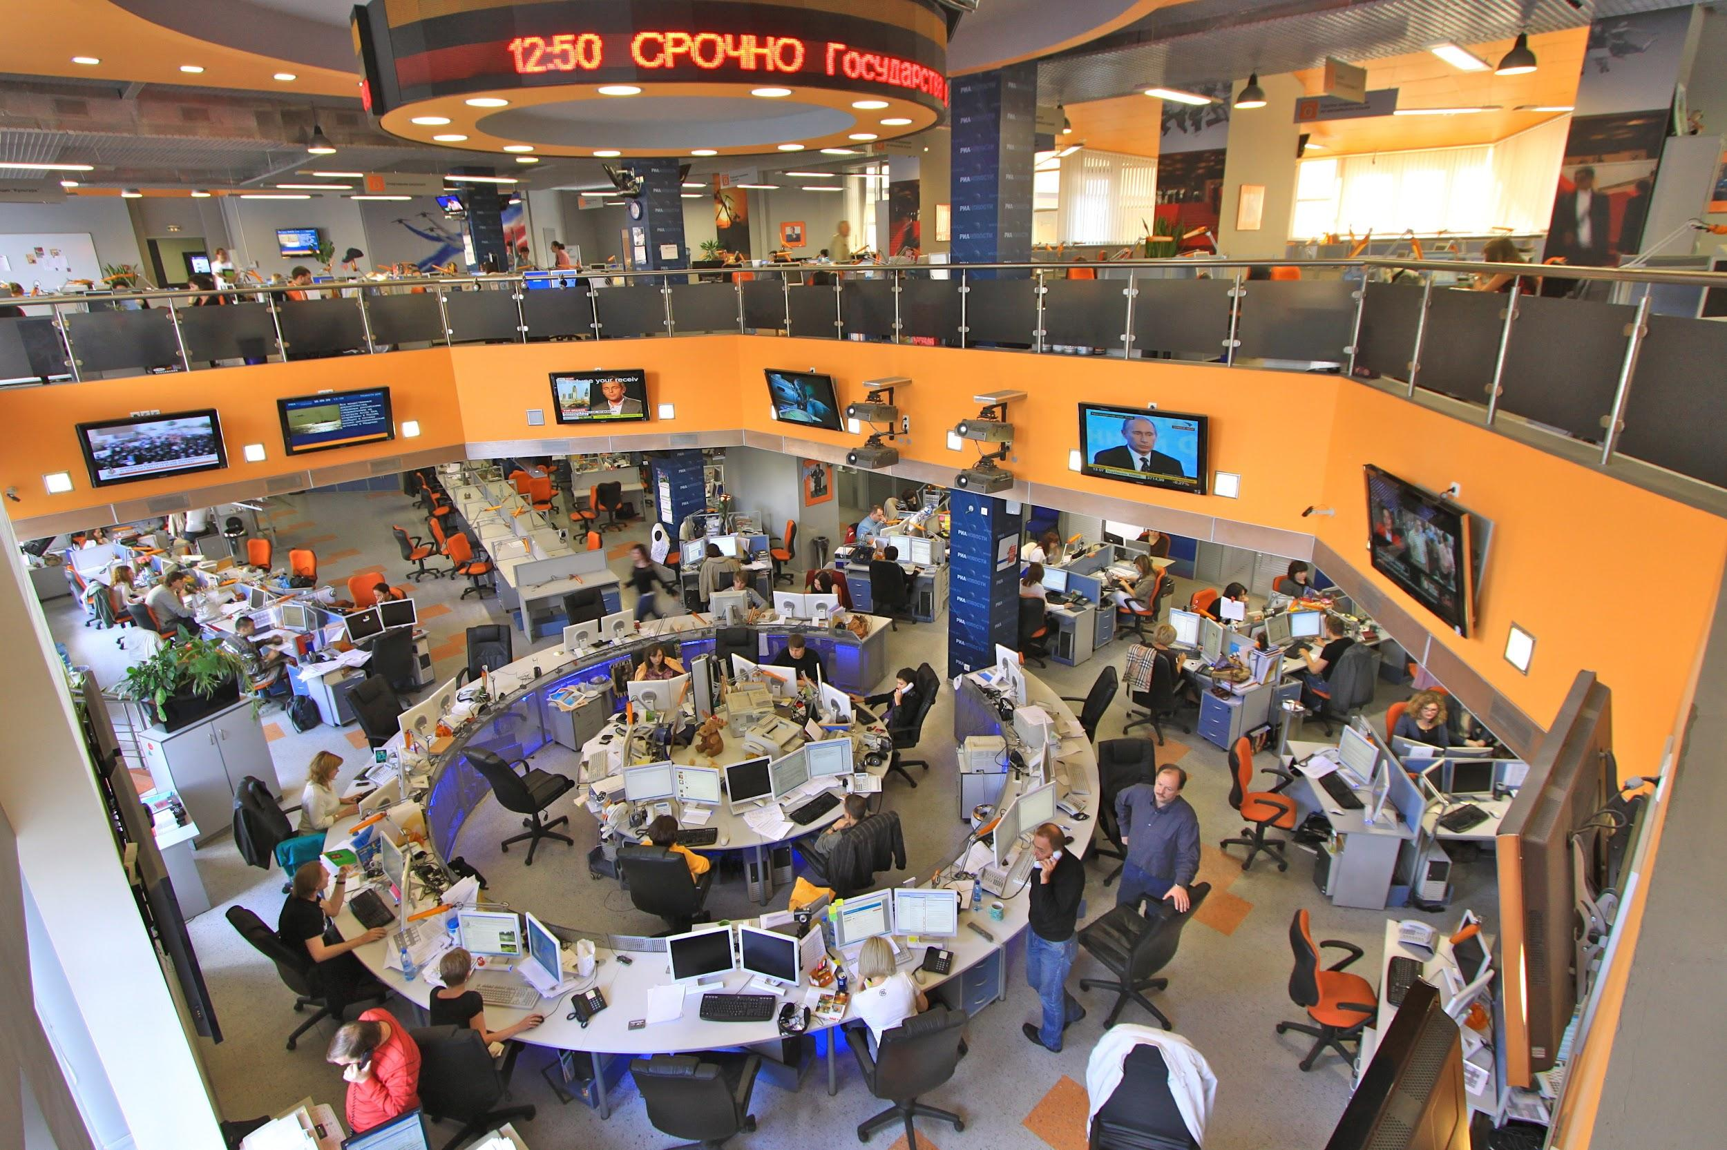
What is a newsroom model?
Notes:
Cristina -
Brief
Transparent
Timely
Individuals, not bureaucracies
Bylines

Slide 6
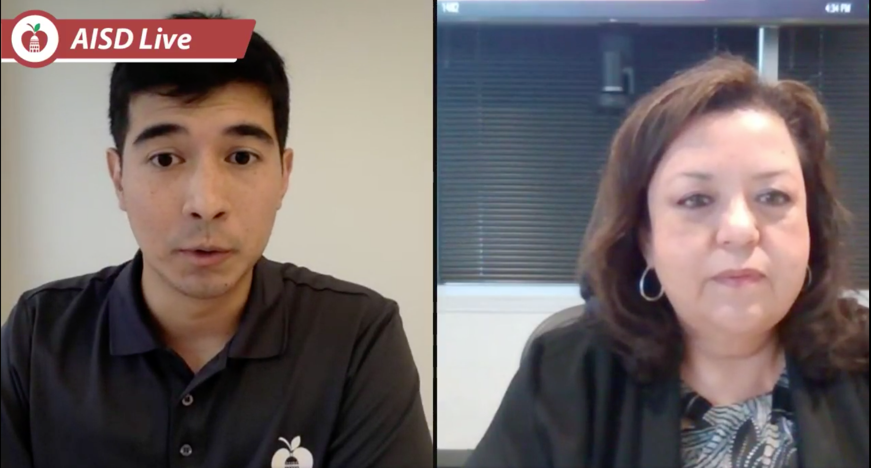
Early successes
Notes:
Scott
Story on special education
Laid out the facts in an honest, smart way
Saw media following our story, not responding
Broadcast on FB Live
Pick up questions from the chat, even from our harshest critics
Not here to sale you, here to inform you.
We used to hope they followed our press release.
Saved time for the media relations team.
Still a big block of text though

Slide 7
Upping Our Game
Notes:
Formal training
Newsletters

Slide 8
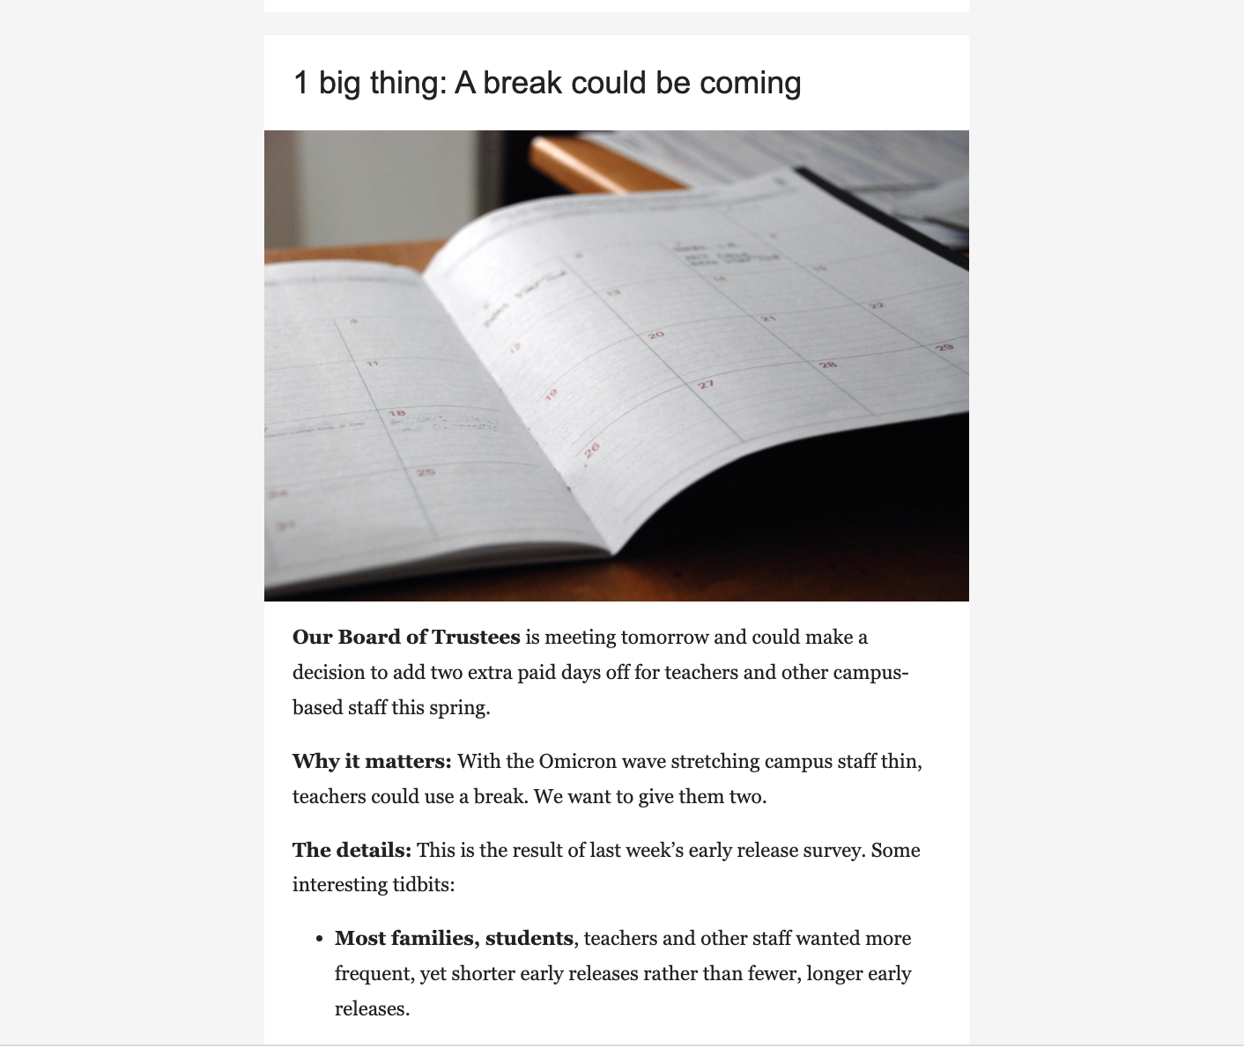
Upping Our Game
Notes:
Cristina

Slide 9
Smart Brevity Fundamentals
Notes:
Scott
Create a place for them to go to more information
Write for people who scroll,
Write for the person who everyone else asks what’s
Create other communication channels for non-influencer
Use Let’s Talk for Service Journalism
Public input/community engagement

Slide 10
Smart Brevity Fundamentals
Lead
Notes:
Scott
Create a place for them to go to more information
Write for people who scroll,
Write for the person who everyone else asks what’s
Create other communication channels for non-influencer
Use Let’s Talk for Service Journalism
Public input/community engagement

Slide 11
Smart Brevity Fundamentals
Bolding/Axioms
Notes:
Scott
Create a place for them to go to more information
Write for people who scroll,
Write for the person who everyone else asks what’s
Create other communication channels for non-influencer
Use Let’s Talk for Service Journalism
Public input/community engagement

Slide 12
Smart Brevity Fundamentals
Bullets
Notes:
Scott
Create a place for them to go to more information
Write for people who scroll,
Write for the person who everyone else asks what’s
Create other communication channels for non-influencer
Use Let’s Talk for Service Journalism
Public input/community engagement

Slide 13
Smart Brevity Fundamentals
Go Deeper
Notes:
Scott
Create a place for them to go to more information
Write for people who scroll,
Write for the person who everyone else asks what’s
Create other communication channels for non-influencer
Use Let’s Talk for Service Journalism
Public input/community engagement

Slide 14
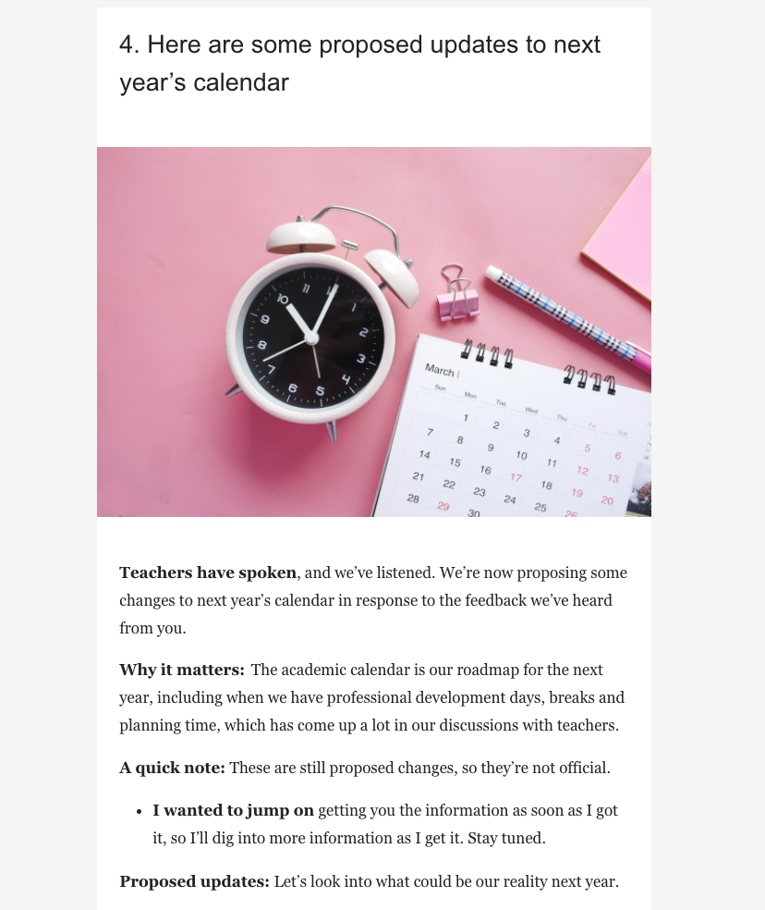
Lessons learned
Notes:
Scott (and Cristina)
Introduction
Schedules
Aligning language and policy

Slide 15
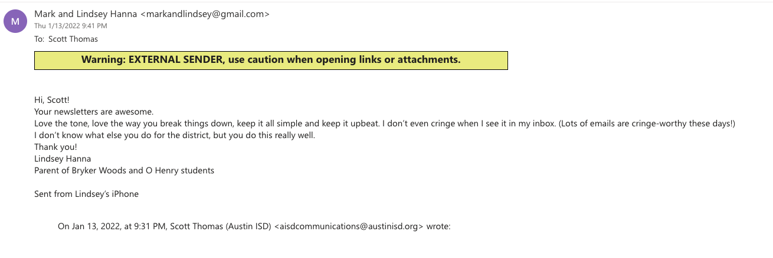
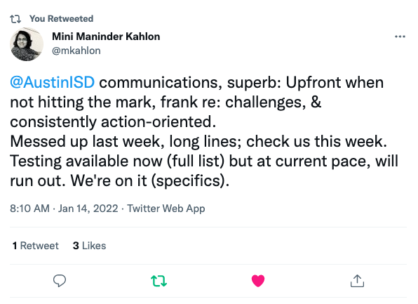
More success
Notes:
Cristina
News following us
Open rates increased
Social Media Sentiment
Positive emails

Slide 16
Questions
Notes:
Introduction

